Slide 1

Agile Refactoring
Refactoring
Iterative Improvement for Software Resilience
Hybrid Model
Respondent: Hanzala, Yousaf, Hassan
Instructor: Sir. Abdul Rehman
Agile Methodologies

Slide 2
CONTENTS
1. Introduction
2. Literature Review
3. Methodology
4. Architecture
5. Solution
6. Case Study
7. Conclusion

Slide 3
Research Questions
1. Introduction
Research Objectives
Research Hypothesis

Slide 4
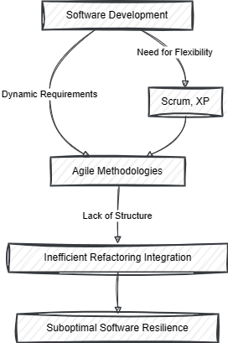
Introduction
01
Research Questions
How do advanced refactoring techniques and particular agile methodologies help improve software resilience?
What are the gaps in Pair Programming, XP, and Scrum's integration of these refactoring techniques?
How might the best possible software resilience be achieved by integrating these approaches with refactoring techniques?

Slide 5
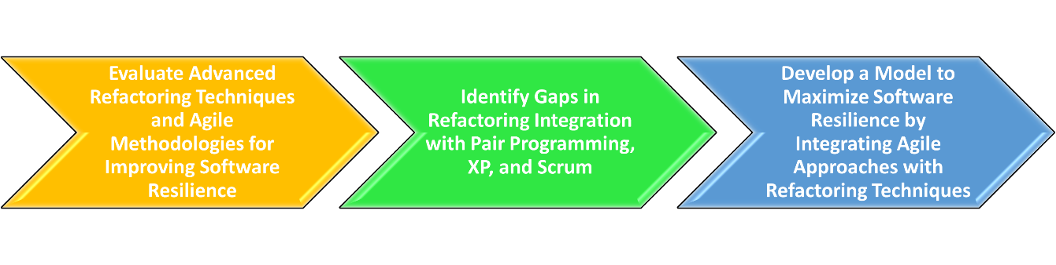
Introduction
02
Research Objectives
To evaluate the contribution of advanced refactoring techniques, Scrum, XP, and Pair Programming to software resilience.
To identify and examine these refactoring practices' integration holes inside XP and Scrum.
To create a model that maximizes software resilience by skillfully fusing these agile approaches with refactoring techniques.

Slide 6
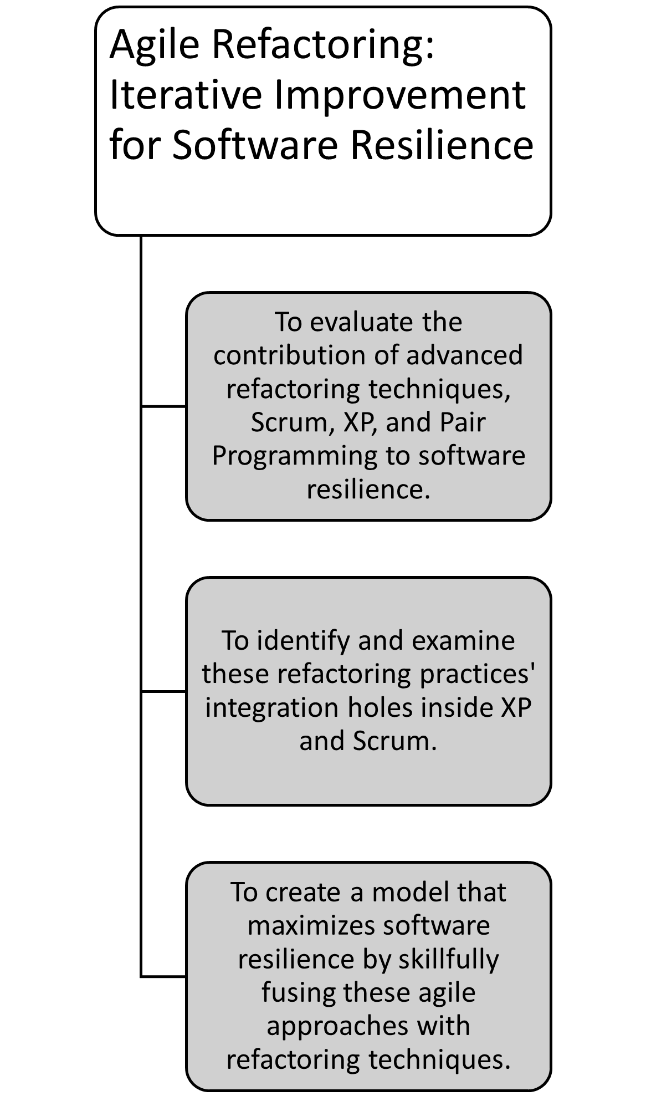
Introduction
03
Research Hypothesis
H1: Agile techniques do not provide a complete process for improving quality of code and maintainability by using structured refactoring techniques.
H2: a methodological approach to employing advanced refactoring techniques into Scrum, XP, and Pair Programming greatly expands software resilience.

Slide 7
Agile Techniques
2. Literature Review
Refactoring Techniques
Impact Of Software Development Process

Slide 8

Literature Review
Literature Paper 1
Literature Paper 2
Literature Paper 3
Literature Paper 4
Explore the integration of agile practices in software engineering education
Analyze the impact of software development processes on software standard
Measure and improve agile processes within small software development companies.
Explore practitioners' perspectives on refactoring techniques for improving software quality.

Slide 9
Scrum
3. Methodology
CI / CD
Refactoring

Slide 10
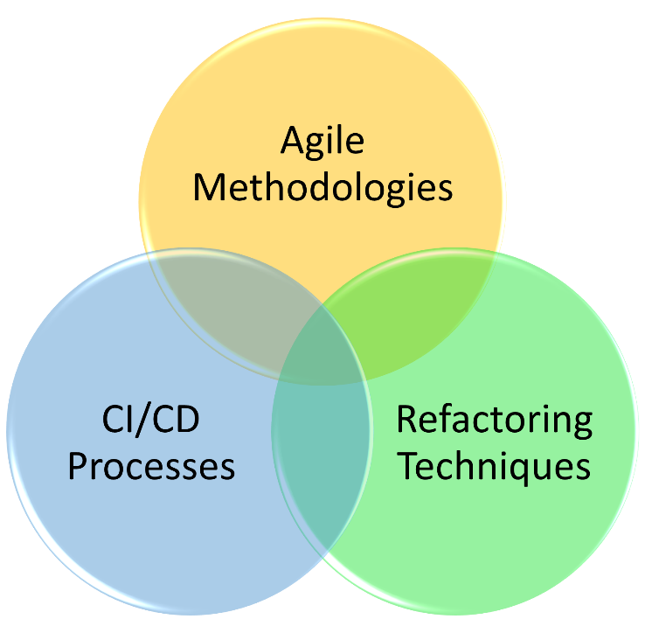
Methodology
01
Answering Research Questions
Agile Methodology Gap
Refactoring Techniques Integration
CI / CD Processes

Slide 11
Scrum
4. Architecture
CI / CD
Refactoring

Slide 12
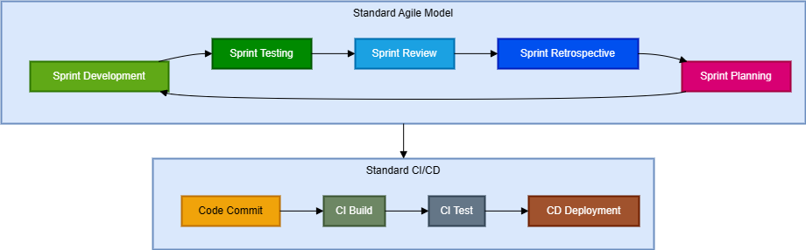
Architecture
01
Standard Architecture
Scrum Sprint
XP Practices TDD
Consistent Feedback
CI / CD Procedures

Slide 13
Scrum Sprint
5. Solution
CI / CD
Refactoring

Slide 14
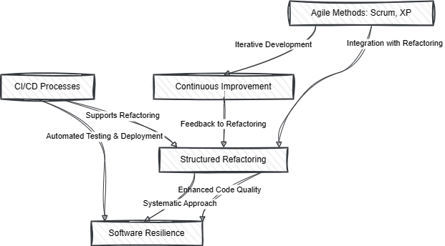
Solution
01
Hybrid Model(Scrum+XP+ Refactoring)
Scrum Sprint (Two Weeks)
XP Practices TDD
Refactoring
Sprint Review and Retrospective
CI / CD Procedures

Slide 15
Background
Case Study
Approaches Applied
Comparative Analysis

Slide 16
Case Study
01
02
03
Background
Previous Approach
Hybrid Approach
Legacy Code Base
Improve Quality Of Code
Scrum Employed
Scrum Sprints
Increasing Complexity
Lack Of Focus On Code Quality
Difficulty in refactoring
Scrum + XP + Refactoring
Decreasing Complexity
Lesser Bugs
Code Quality Improvement

Slide 17
Case Study
Tabular Analysis Of Both Approaches
Metric | Previous Approach (Scrum) | Hybrid Approach (Scrum + XP + Refactoring) | Difference
Total Sprints | 20 sprints | 14 sprints | 6 sprints
Total User Story Sprints | 12 sprints | 12 sprints | 0 sprints
Total Bug Fix Sprints | 8 sprints | 2 sprints | 6 sprints
Average Bugs per Sprint | 3 bugs | 1 bug | 2 bugs
Average Duration/Sprint | 2 weeks | 2 weeks | 0 weeks

Slide 18
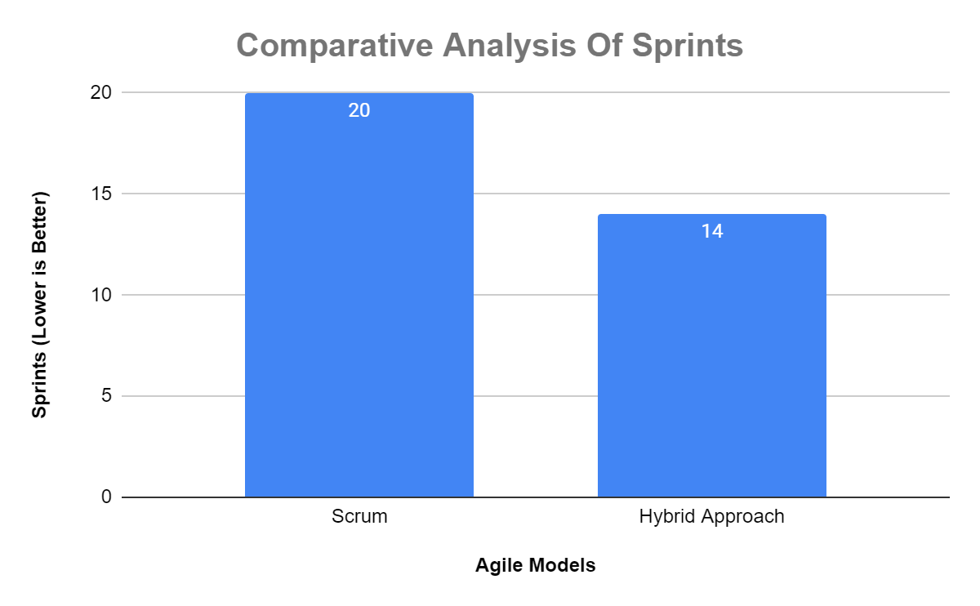
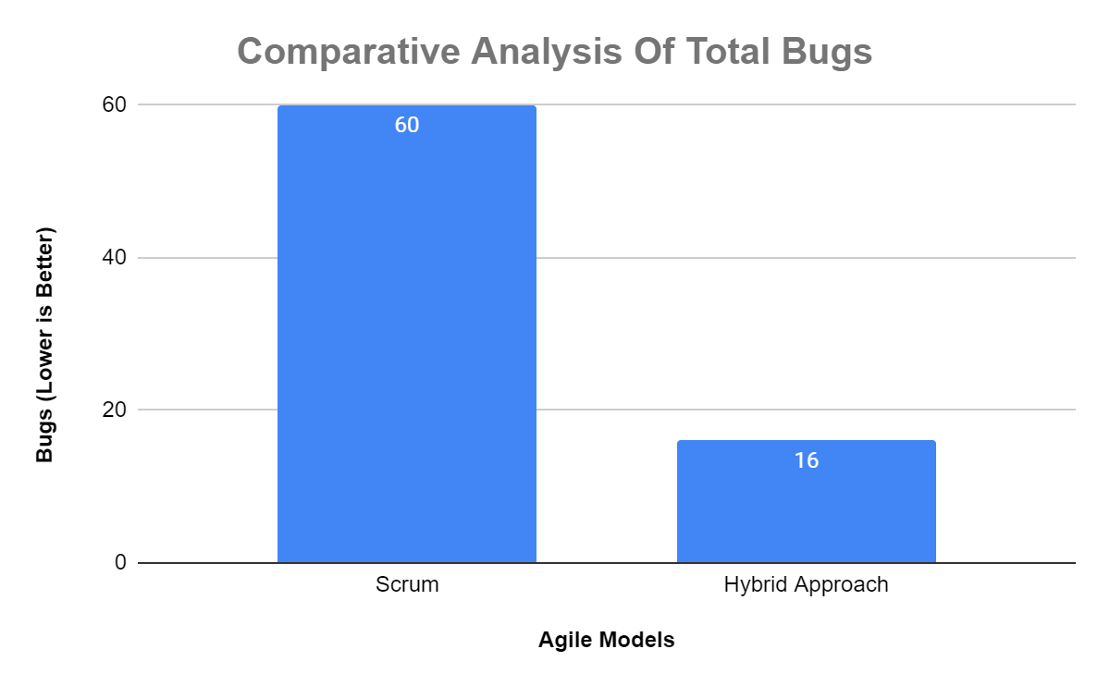

Case Study
Graphical Analysis Of Both Approaches

Slide 19
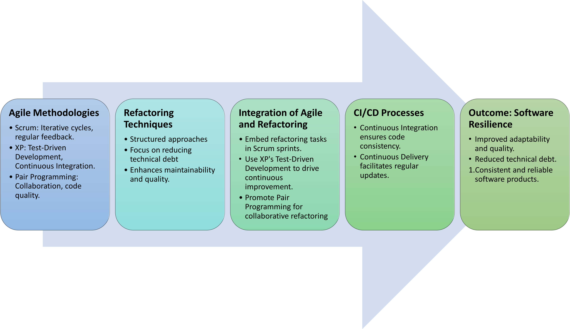
Conclusion
Investigation of agile methodologies and polished refactoring techniques.
Strategic integration of agile practices with structured refactoring techniques.
Need of taking a systematic approach to incorporate refactoring tasks into agile iterative cycles.
The architecture of solution has CI / CD processes which shows to improve the reliability of software products.

Slide 20
THANK
YOU
Respondent: Hanzala, Yousaf , Hassan
Instructor: Sir Abdul Rehman

